Slide 1
Hot Topics in Ministry Finance:
Peaks and Valleys in 2020
Opportunities and Cautions for 2021
Presented by
Corey A. Pfaffe, CPA, PhD
February 2021
Notes:
[HEADS UP … White board brainstorming session.]
Try to put yourself in the shoes of your business office people. Or maybe you’re that one and after 2020 your toes are peeking out of your well-worn tennis shoes!
While 2020 had peaks and valleys on many fronts, what was the landscape like for your business affairs? If we were to compare your financial resources and obligations at 1/1/2020 to those at 1/1/2021 what smiles and frowns would be on the ministry “face”?

Slide 2
Peaks & Valleys: What We Saw in 2020
Peaks Valleys
Revenues, costs & budgets
Government programs/actions
Giving
Stakeholder uncertainty
“Change”
Peaks and Valleys in 2020
Opportunities and Cautions for 2021
Notes:
Revenues, costs & budgets
Peaks:
Ministries with mature budgeting systems (more discussion to follow re: dynamic budgeting; contingency funds; prompt financial reporting, especially actual year-to-date compared to the annual budget with %s on the P&L and transparent designated fund balances on the balance sheet)
Ministries that had reserves (15% of annual budget as a target)
Valleys:
Loss of program revenues
Additional costs for COVID-19 precautions
Ministries with high fixed costs, especially with debt or full staffs on salary
Government programs
Peaks:
CARES Act PPP loan/grants
CARES Act Employee Retention Credits
Families First Coronavirus Recovery Act Credits
State programs
Valleys:
Complexity of CARES Act and numerous SBA FAQs
Uncertainty about risks of accepting government assistance
Government “Orders” of all types
Giving
Peaks:
Many different experiences…?Initial March – May surge; June – October lull; November – now stabilized?
Online giving
$300 above-the-line deduction in 2020
Valleys: Few donors seemed to view their stimulus checks as opportunities to bless ministries
Stakeholder uncertainty
Peaks: Well prepared and loyal donors responded quickly
Valleys:
Fear of exposure to the virus (i.e., getting sick) kept constituents away
Fear of quarantine (i.e., being “put in jail”) kept constituents away
Marginal “customers” had their “scales tipped” against program involvement
“Change”
Peaks:
New ways considered for reaching constituencies—remote, podcasts, etc.
80/20 thinking—re-evaluating programs
Valleys:
Fear of uncertainty over short-term versus long-term effects of 2020
Too little “organizational slack” leading to resistance to change
Other? Disengagement by volunteer boards and staff; Spectator versus “all in” stakeholders

Slide 3
Opportunity in 2021: CAA
PPP2 loan/grants
Even if received a PPP1 loan/grant
Eligibility
25% decline in gross receipts (program and all contributions), or
Fully or partially shut down under government “orders”
2.5 months of 2019 average payroll costs
Forgivable costs only through March 31, 2021
Peaks and Valleys in 2020
Opportunities and Cautions for 2021

Slide 4
Opportunity in 2021: CAA (continued)
Employee retention credit
Even if received a PPP1 loan/grant
Eligibility
50% decline in 2020 gross receipts or 20% decline in 2021 gross receipts compared to 2019, or
Fully or partially shut down under government “orders”
Substantial “refundable” credits against FICA tax
:^( Ministers’ SECA wages don’t qualify
Peaks and Valleys in 2020
Opportunities and Cautions for 2021

Slide 5
Opportunity in 2021: CAA (continued)
FFCRA paid sick leave / family leave credits
$600 above-the-line charitable write-off for MFJ
Up to $5,250 tax-free employer pay downs on employee student loans through 2025*
Peaks and Valleys in 2020
Opportunities and Cautions for 2021
Notes:
Families First Coronavirus Relief Act
* Question: Could this benefit be extended to college grads who serve on summer staff?

Slide 6
Opportunity in 2021: Budgeting Improvements
Cash is king!
Dynamic budgeting
Contingency fund
Financial reporting, especially actual year-to-date compared to the annual budget with %s on the P&L
Transparent designated fund balances on the balance sheet
General Fund reserve balance
Peaks and Valleys in 2020
Opportunities and Cautions for 2021
Notes:
https://unsplash.com/photos/5fNmWej4tAA
1.
Regardless your standard accounting methods, we recommend the modified cash basis for ministry budgeting (versus full GAAP accounting). By using the modified cash basis, you have a Cash in and Cash out approach that non-accountants can better grasp. Yet, accounts receivable and accounts payable are factored in. In that way, last minute purchases before year-end still get counted in that year’s budget even though the payment isn’t made until the next fiscal year.
This means that you include in your expenditure budget principal payments on debt AND capital expenditures for major equipment, etc. But you ignore depreciation entries. Also, strange as it may sound, you include loan proceeds as a source of cash.
2.
Revenues are projected. Expenditures are authorized. Opportunities and threats don’t wait for next year’s budget. You need flexibility. Take, for example, the proverbial capital expenditures “wish list.” You have one, right? If not, I’m guessing that your facilities person does!
Dynamic budgeting involves interim analyses of your actual to budget year-to-date results which can lead to authorized revisions to the annual budget. Timing? How about after winter programming is concluded? And then revisit after summer programming?
Make your budgeting from start to finish “participatory.”
3.
Proverb 22.3 –
Challenges will occur that cannot be anticipated at the time of preparing the annual budget: revenue shortfalls; non-discretionary and discretionary expenditure overruns. A “Contingency Fund” is not a fund at all. But a budget line-item actual chart of accounts option within your expenditures. Yet, only a budget is provided for it. No transaction postings are ever made to it. Instead, as you analyze interim results and find threats to living within your budget, you can decrease the Contingency Fund budget and increase the affect revenue or expenditure budget.
Opportunities can arise upon revenue surpluses, expenditure savings. When this happens the “wish list” can be revisited.
4.
5.
Check out our MinistryCPA blog post for ideas. Your budget (and the related P&L or “Statement of Activity”) is for the General Fund. Designated Gifts ARE NOT budgeted; they are spent in accordance with donor designations.
6.
Work toward a General Fund reserve balance of at least 15% of your annual general fund budget. Avoid LIKE THE COVID-19 PLAGUE the almost always unwise “Board Designated Fund.”

Slide 7
Opportunity in 2021: Vision casting
Vision Statement
Core Values
Aspirational Values
“Uniques”
Thematic Goals
Defining Objectives
Peaks and Valleys in 2020
Opportunities and Cautions for 2021
Notes:
https://unsplash.com/photos/5fNmWej4tAA
MinistryCPA
1. Vision Statement: To help others improve their financial stewardship.
MinistryCPA Motto: Reaching globally, serving personally.
2. Core Values (identified, unchanging values):
Uncompromising Integrity …
Wired to Serve …
Micah 6.8 Team Players
They “do justly” as hungry self-motivated and diligent people.
They “love mercy” as people smart individuals who have common sense about people.
They “walk humbly” as humble team members who define success collectively.
3. Aspirational Values:
Family and Employee First—...
“Lean” Leadership—...
4. Strategic Anchors which we believe will 1) give us the best chance to thrive and 2) differentiate us from competitors (our “uniques”).
We have a personal relationship with Jesus Christ.
We are committed to the purposes of MinistryCPA and one another’s welfare.
We pursue a highly relational and responsive service orientation toward our clients.
We use innovative technologies and systems to effectively and efficiently serve local and remote clients.
5. Annual BIG 3 to 4 goals
6. Assign accountability by individual or department

Slide 8
Cautions:
What We See for 2021
Bostock v. Clayton County, Georgia
Avoid becoming a target
Peaks and Valleys in 2020
Opportunities and Cautions for 2021

Slide 9
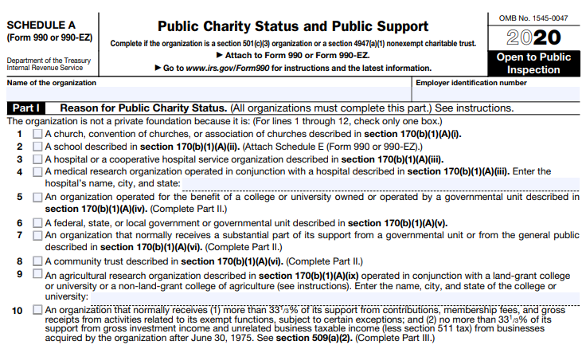
Caution in 2021: Bostock v. Clayton County, GA
Peaks and Valleys in 2020
Opportunities and Cautions for 2021
Notes:
Title VII of the Civil Rights Act of 1964 provides:
“It shall be an unlawful employment practice for an employer . . . to fail or refuse to hire or to discharge any individual, or otherwise to discriminate against any individual with respect to his compensation, terms, conditions, or privileges of employment, because of such individual’s race, color, religion, sex, or national origin.^{[4]}”
SUPREME COURT QUESTION
Does Title VII of the Civil Rights Act of 1964, which prohibits against employment discrimination “because of . . . sex” encompass discrimination based on an individual’s sexual orientation?
The court reversed the decision of the 11th Circuit in a 6-3 ruling, holding "an employer who fires an individual merely for being gay or transgender violates Title VII.“
Question: Will the FFRF attack the “religion” word in the Civil Rights Act next seeking to force religious employers to hire employees of religions other than their own?

Slide 10
Caution in 2021: Avoid becoming a target
IRS Form 990 and State compliance
Compensation compliance
UBIT: non-mission related income; debt issues; rental of real estate
Sales tax compliance
Local real estate tax exemptions
Notes:
https://unsplash.com/photos/t3IYuQZRDNE
Compensation compliance “checklist”—”When you don’t know what you don’t know” MinistryCPA blog post
Please check all compliance requirements that are currently being met:
File quarterly Form 941 or annual Form 944 with the IRS
Issue Forms W-2 to all employees and File Forms W-2/ W-3 with SSA
Ministerial Housing Allowance is only listed in box 14 of the Form W-2 – it is not included in box 1
Obtain Form W-9 from all individuals/businesses that are paid the cumulative total of $600 or more in the year for services rendered
Issue Forms 1099-NEC and 1099-Misc and file them with the IRS by January 31st
Provide charitable giving statements with the appropriate IRS verbiage

